Slide 1
Is face recognition ready and helpful in our enterprises?
Notes:
Example of ML applied to images. We want to have it work on parts, subassemblies.
Here’s someone we don’t know. If we train it correctly, here’s what we could find.

Slide 2
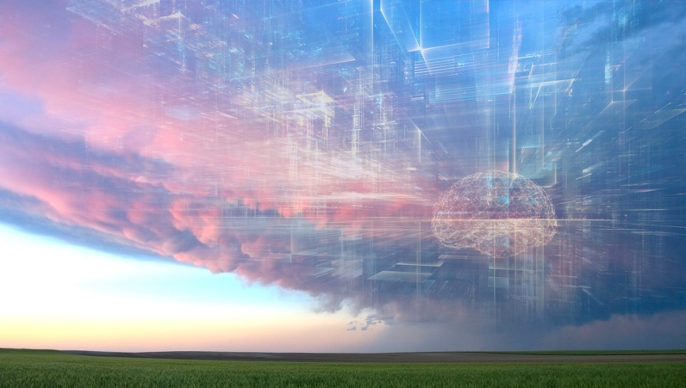
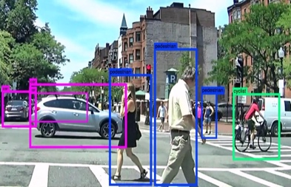
Surfing the next major technology waves - Summary
New Habits
Cyber Security challenges
Work from anywhere, always connected, gaming, sharing, open source, reduced footprint, cord-cutting
At scale, authentication, encryption by default, role-based training, BlockChain
Applied AI
Built in
intelligence
everywhere
Deep Learning, Machine Learning, chatbots, NLP, automation, data-driven, APIs, analytics, combinations
Accelerated Computing
Serverless, edge computing, HPC, GPUs, Neuromorphic, Quantum
Ubiquitous Computing
Software Defined Everything
Mobile, smart devices, AR, IoT, NUI
Programming everything, APIs, Software Defined Networks, containers, DevOps, Open Source, self-healing, everything distributed
These waves will impact everyone
These waves will impact primarily developers
Participate at: techwaves@jpl.nasa.gov or https://goto.jpl.nasa.gov/techwaves
Notes:
Other potentials:
From IDC: Technologies covered include distributed cloud, pervasive AI, composable applications, blockchain, diversified IoT, and more.
Everything as code, Automating Cyber Security for diversity and scale, Intelligent automation
1. Preparing for Software Defined Everything
Programming, SDN, containers, DevOps, Open Software, Intelligent network, devices
2. Accelerating the computing
Cloud, Serverless, cloud edge, HPC, GPUs, Quantum
3. Living mobile in a mixed reality
Mobile, smart devices, AR, IoT, NUI, customization
4. Automating Intelligence: Measuring & Automating Everything
AI, chatbots, NLP, automation, data, APIs, analytics, combinations
5. Handling Cyber Security challenges at scale
Scale, authentication, encryption, BlockChain
6. Adjusting to changing workforce expectations and habits
Work from anywhere, gaming, sharing, open source, reduced footprint, cord-cutting

Slide 3
NASA MISSIONS Where do you want to go tomorrow?

Slide 4
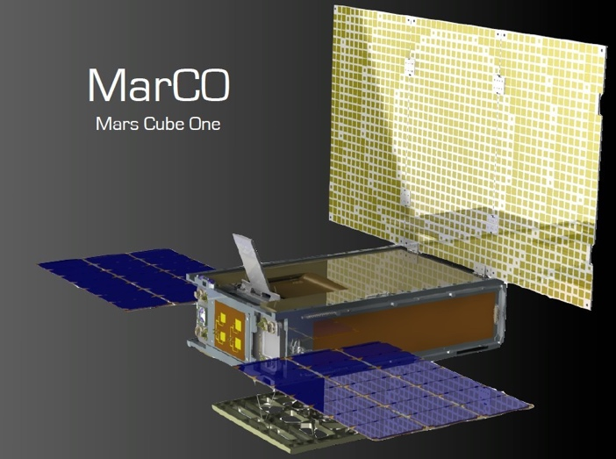
Seven new mission launched in May 2018 (a JPL record)
Cold Atom Lab and Raincube
InSight lander
Two Mars CubeSat Ones
TEMPEST-D CubeSat
CubeRRT CubeSat
GRACE-FO
Notes:
Photo 1: GRACE-FO launch, Cold Atom Lab illustration, Raincube illustration. Photo 2: InSight launch. Photo 3: InSight lander. Photo 4: TEMPEST-D CubeSat. Photo 5: CubeRRT CubeSat illustration. Photo 6: GRACE-FO illustration.
Seven JPL missions launched from California’s Vandenberg Air Force Base and the Wallops Flight Facility in Virginia.
InSight mission to Mars
MarCO CubeSats to Mars
Cold Atom Laboratory instrument to ISS
Three Earth-observing CubeSats
GRACE Follow-On mission

Slide 5
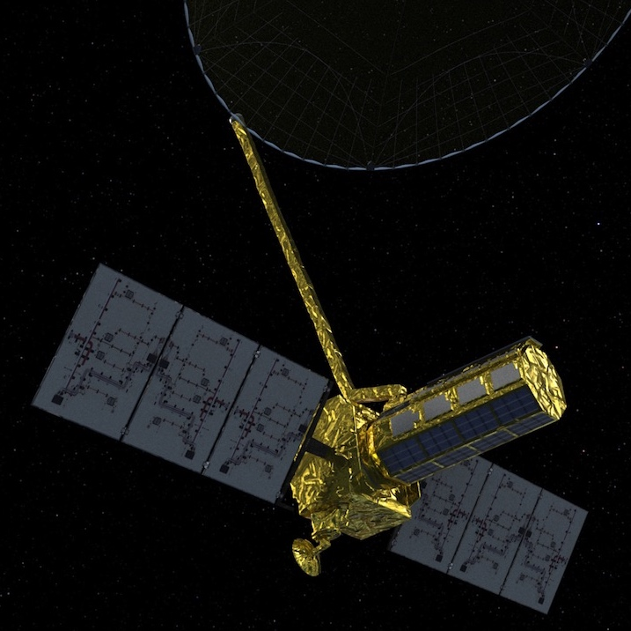
Understand the Earth’s water in detail with SWOT and NISAR
HOW CAN WE PROTECT EARTH AGAINST
a giant errant asteroid?
we will collect 100x more
Data
SWOT &
NISAR
100 TB/day
2021
SMAP
2015
OCO-2
2009
Notes:
About 2022 launch to measure and understand and predict the water table down to rivers and reservoirs.
Because the data is so large, it won’t fit in our data centers, so we’ll use cloud computing.
It’s a good thing that we saw this toy to tool progression 10 years ago and began to experiment. The vendors became partners and we have helped evolve cloud computing to where it is today and we continue to push the frontier boundary while using it operationally.

Slide 6
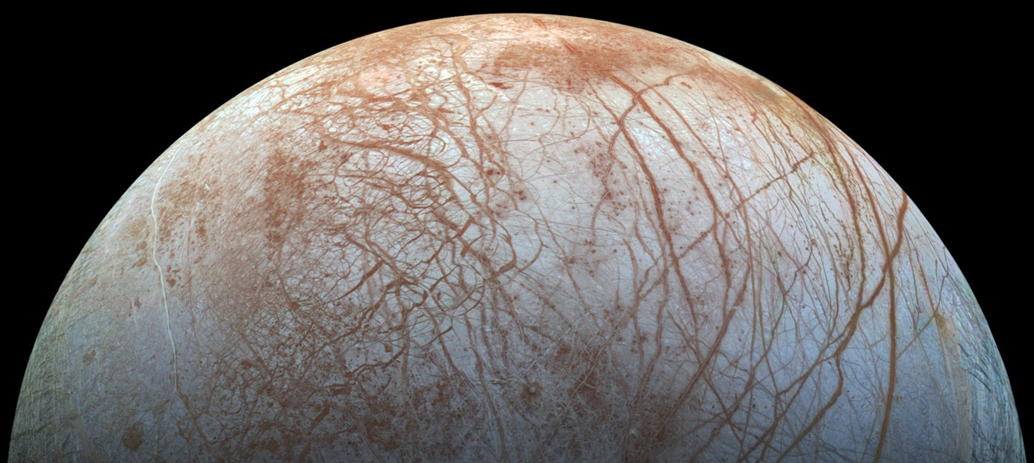
Is there life on Europa?
Notes:
Europa is covered by ice (10 mile thick). Ice is about water (2x the amount on Earth). Water is about the potential for life.
Because it’s such a large challenging mission, with many partners, we’ll use cloud computing for development and execution.

Slide 7
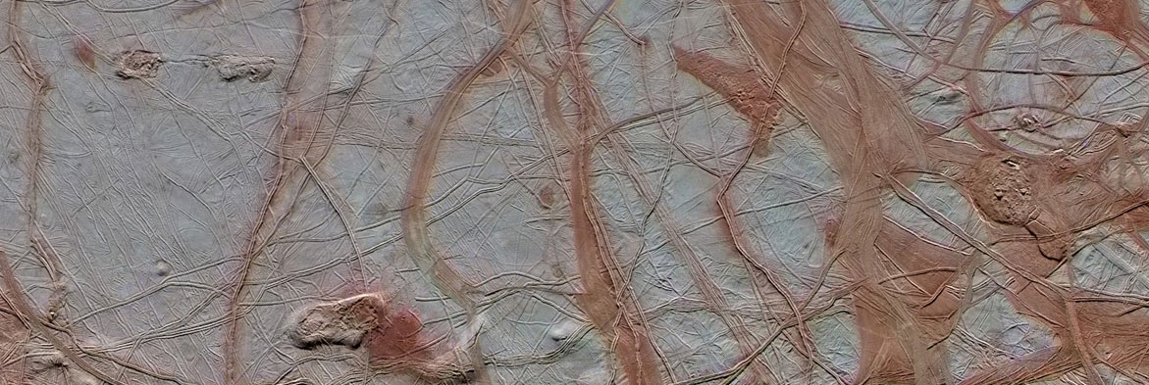
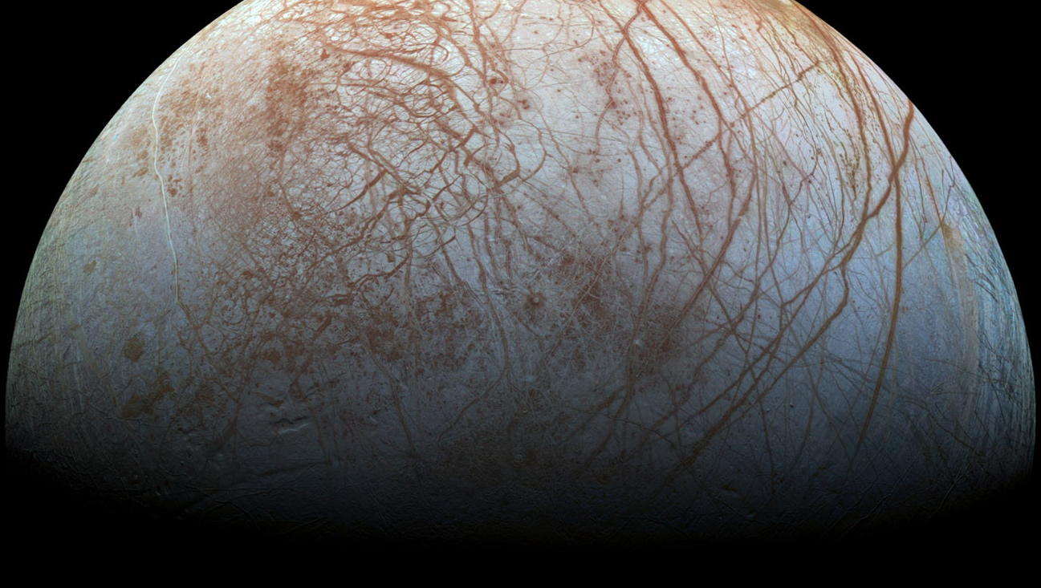
Notes:
No craters. Jupiter’s gravity moves the ice, like the ice flows at the Earth’s Arctic. Send orbiter, lander, later melt through the ice to search for life in the water. It will take a lot of simulation and models and we’re using Model Based Engineering,
The Europa mission began in AWS GovCloud. Why do we care? Because it makes us faster to get started, reduces risk, cost less, and we can make changes quicker.

Slide 8
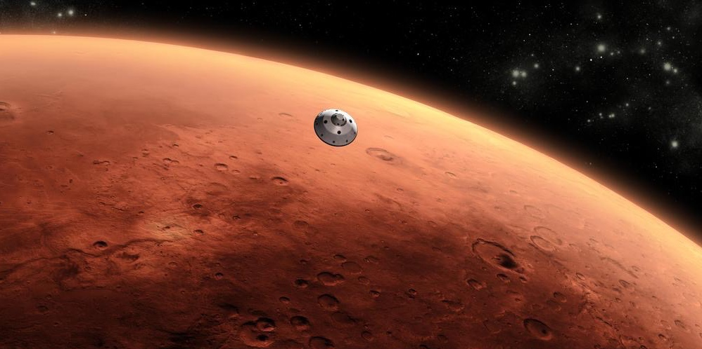
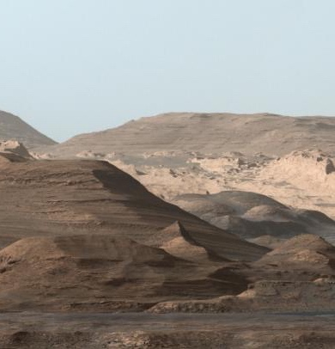
HOW DO WE PREPARE FOR
Humans on Mars?
Notes:
We want to send humans to Mars and we want to know if there is/was life on Mars.

Slide 9
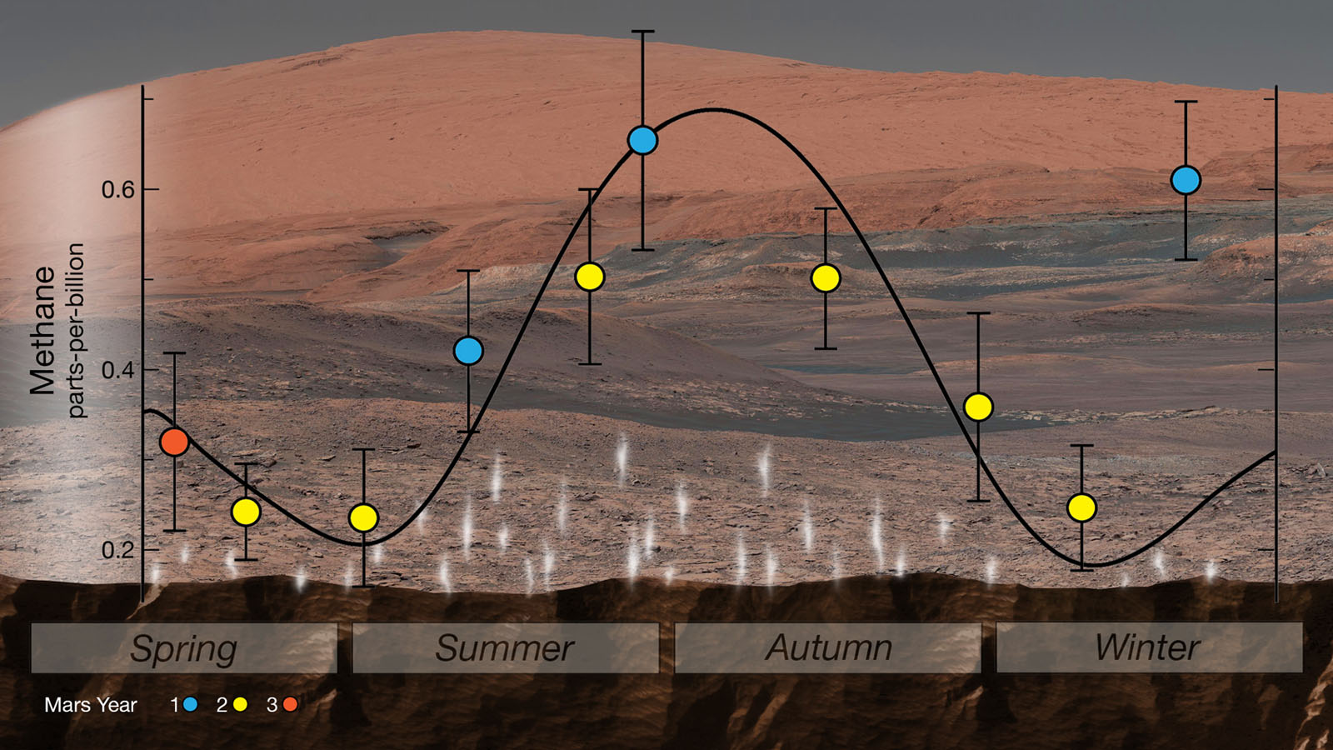
Mars Mysterious Methane
Notes:
NASA's Curiosity rover used an instrument called SAM (Sample Analysis at Mars) to detect seasonal changes in atmospheric methane in Gale Crater. The methane signal has been observed for nearly three Martian years (nearly six Earth years), peaking each summer.
This work was funded by NASA's Mars Exploration Program for the agency's Science Mission Directorate (SMD) in Washington. Goddard provided the SAM instrument. JPL built the rover and manages the project for SMD.

Slide 10
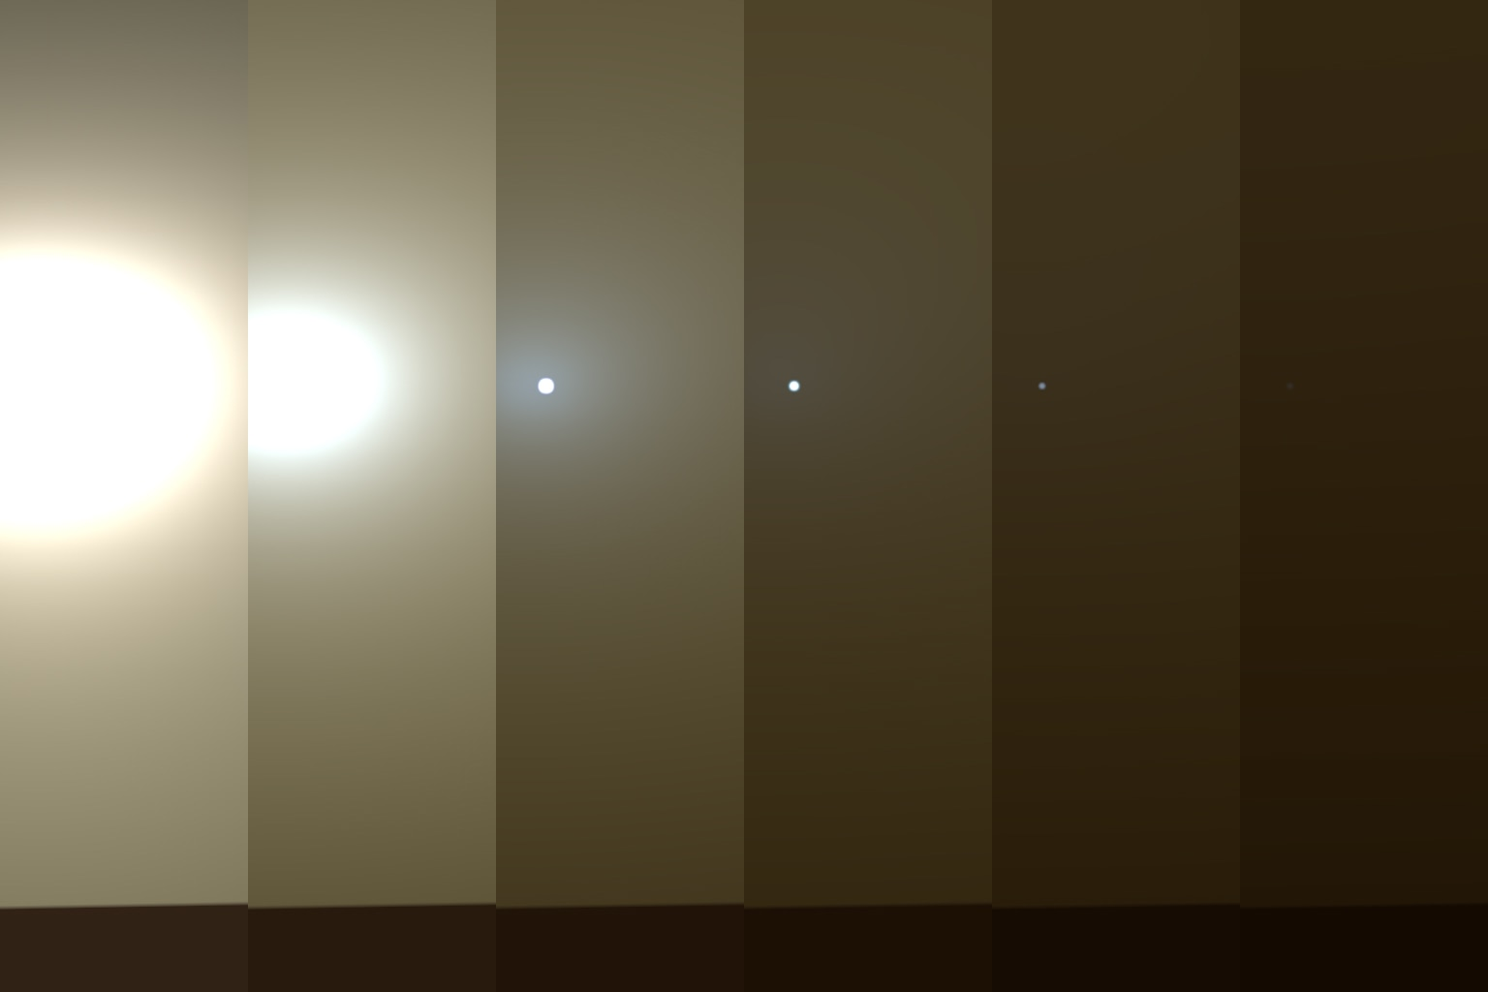
Opportunity Hunkers Down During Dust Storm
Notes:
This series of images shows simulated views of a darkening Martian sky blotting out the Sun from the Opportunity rover's point of view, with the right side simulating Opportunity's current view in the global dust storm (June 2018). The left starts with a blindingly bright mid-afternoon sky, with the sun appearing bigger because of brightness. The right shows the Sun so obscured by dust it looks like a pinprick.
NASA engineers try to contact the Opportunity rover every day during the storm but have not heard back from the nearly 15-year old rover. The team is now operating under the assumption that the charge in Opportunity's batteries has dipped below 24 volts and the rover has entered low power fault mode, a condition where all subsystems, except a mission clock, are turned off. The rover's mission clock is programmed to wake the computer so it can check power levels.
If the rover's computer determines that its batteries don't have enough charge, it will again put itself back to sleep. Due to an extreme amount of dust over Perseverance Valley, mission engineers believe it is unlikely the rover has enough sunlight to charge back up for at least the next several days.
The Martian dust storm that has blotted out the sun above Opportunity has continued to intensify. The storm, which was first detected on May 30, now blankets 14-million square miles (35-million square kilometers) of Martian surface -- a quarter of the planet.

