Slide 1
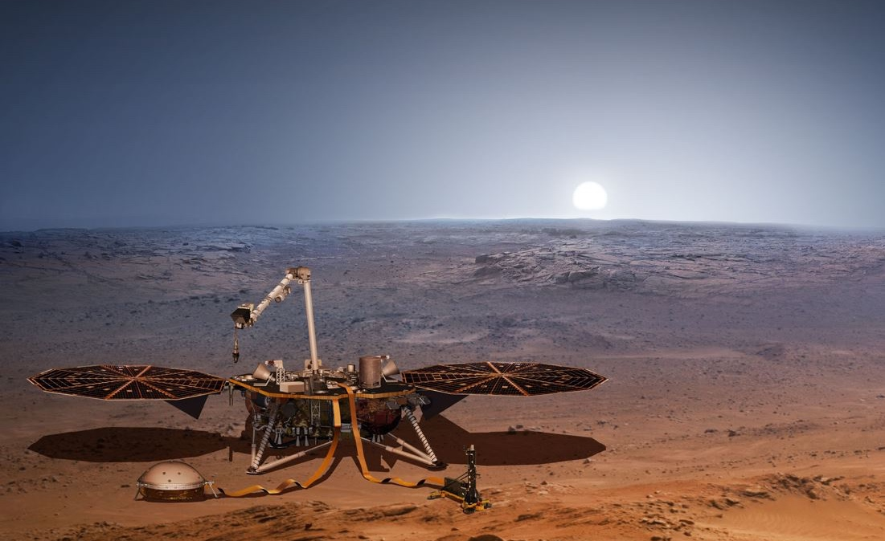
Gain InSight to
Mars’ interior

Slide 2
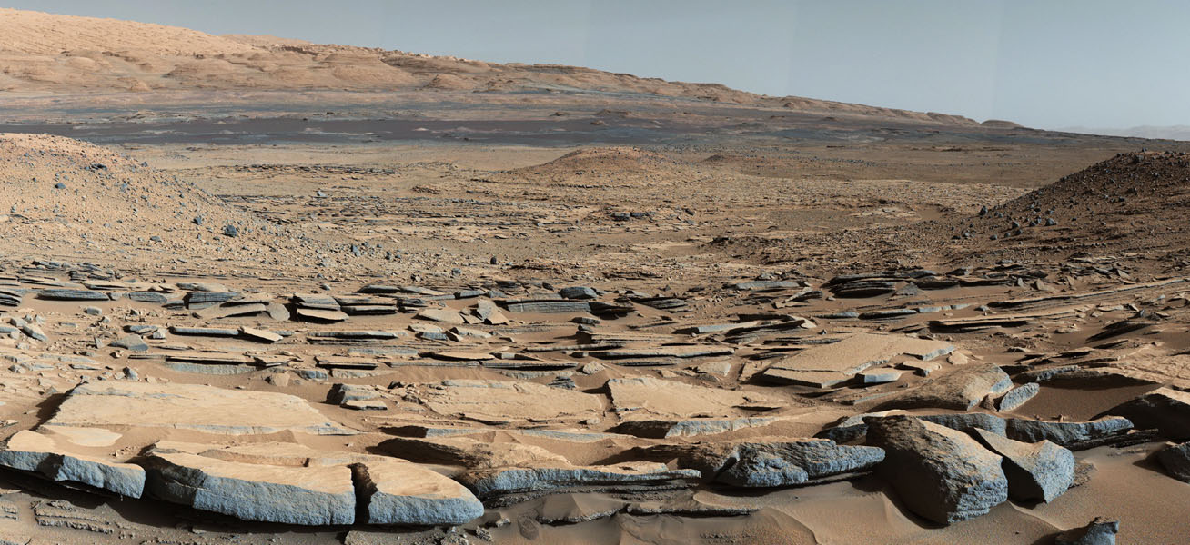
Curiosity: Did/does Mars house life?
Notes:
Here’s a view of the surface of Mars. Do you see life?
We just found organic materials in a rock and in the atmosphere, and it has a cycle. What is the cause of the cycle?
We didn’t find absolute proof, so we’re going back.

Slide 3
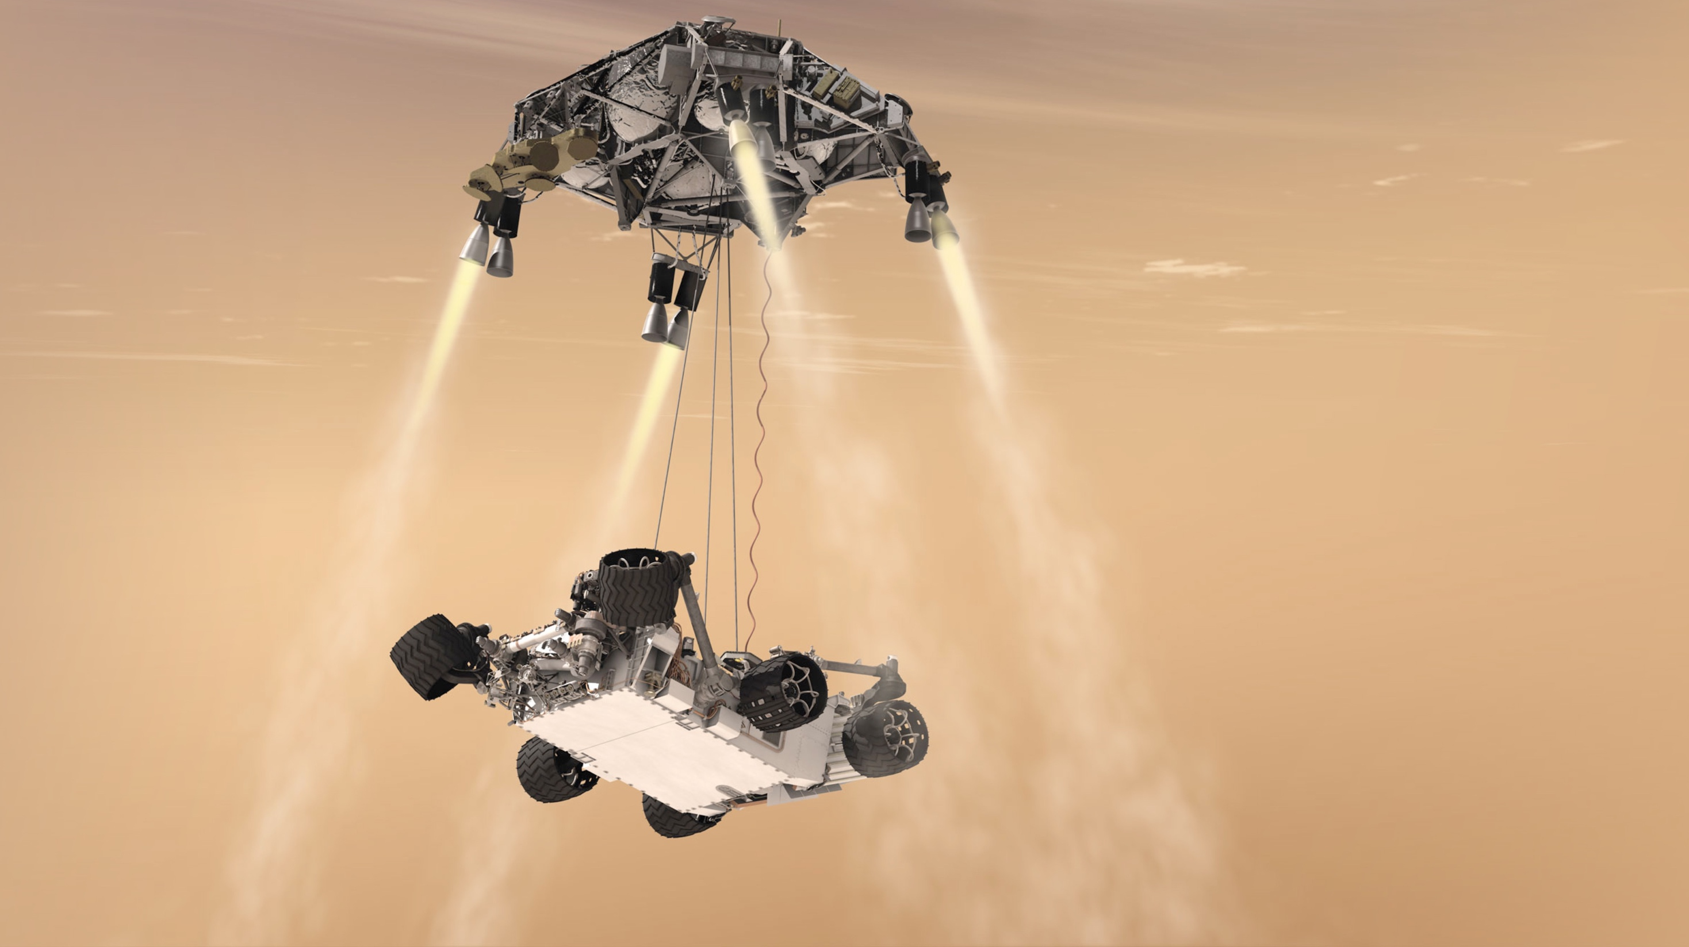
We’re going back!
Notes:
Curiosity and the Mars Exploration Rovers found signs of liquid, even flowing liquid, but not yet the smoking gun that life existed (or exists) on Mars. So, we’re going back with new instruments and new methods and will help pave the way for humans to go to Mars.

