Slide 1
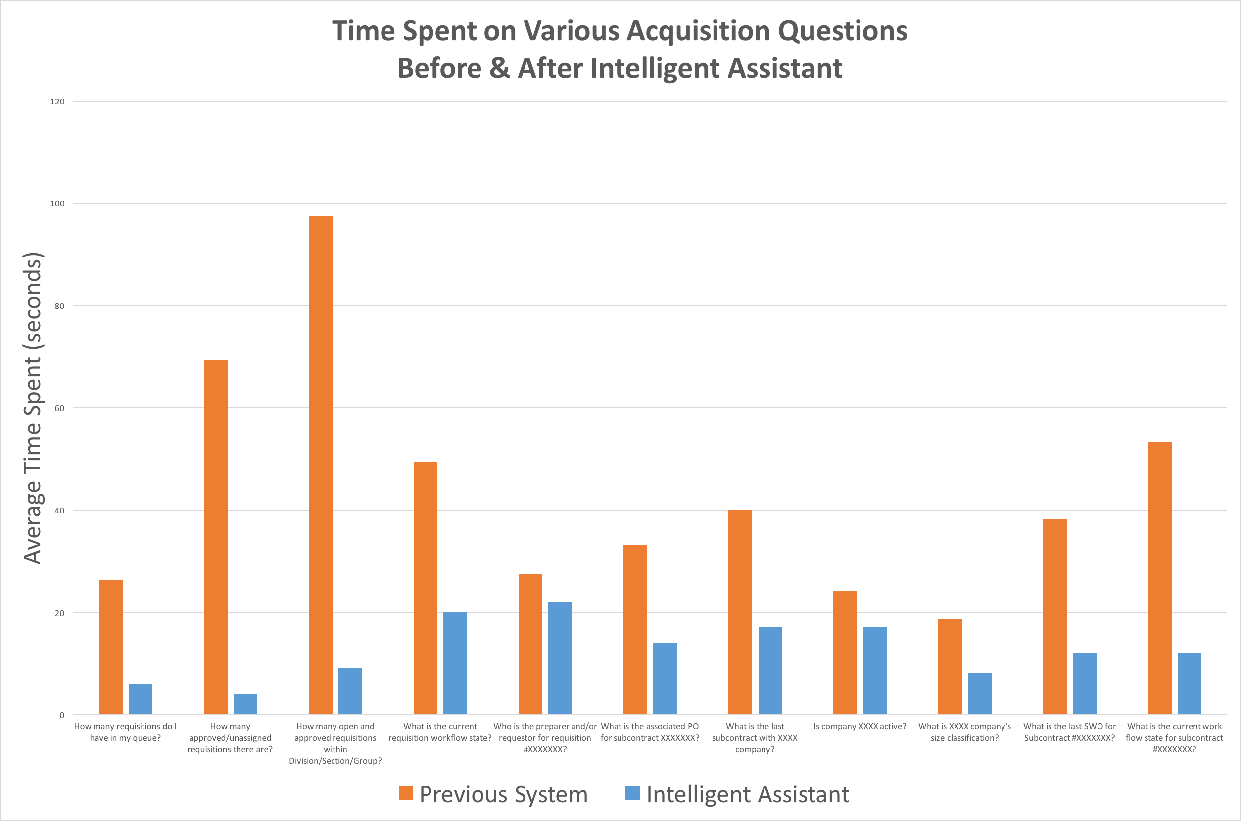
JPL’s Acquisition Intelligent Assistant Results

Slide 2
Rapid Iteration of Acquisition’s Digital Assistant
1. Answering questions…
Iterated into …
2. Having a dialog
POC: M. Cox

Slide 3
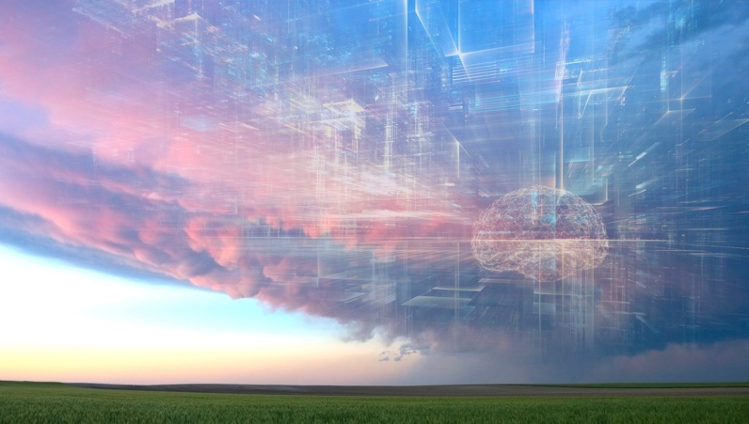
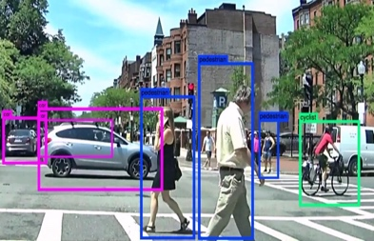
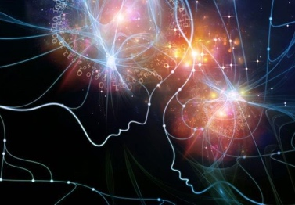
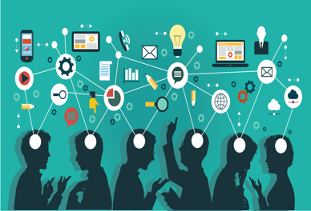
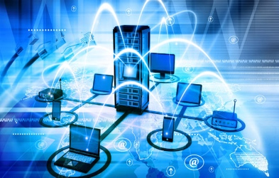
Surfing the next major technology waves – Applied AI
New Habits
Cyber Security challenges
Applied AI
Built in
intelligence
everywhere
Deep Learning, Machine Learning, chatbots, NLP, automation, data-driven, APIs, analytics, combinations
Accelerated Computing
Ubiquitous Computing
Software Defined Everything
These waves will impact everyone
These waves will impact primarily developers
Participate at: techwaves@jpl.nasa.gov or https://goto.jpl.nasa.gov/techwaves
Notes:
Other potentials:
From IDC: Technologies covered include distributed cloud, pervasive AI, composable applications, blockchain, diversified IoT, and more.
Everything as code, Automating Cyber Security for diversity and scale, Intelligent automation
1. Preparing for Software Defined Everything
Programming, SDN, containers, DevOps, Open Software, Intelligent network, devices
2. Accelerating the computing
Cloud, Serverless, cloud edge, HPC, GPUs, Quantum
3. Living mobile in a mixed reality
Mobile, smart devices, AR, IoT, NUI, customization
4. Automating Intelligence: Measuring & Automating Everything
AI, chatbots, NLP, automation, data, APIs, analytics, combinations
5. Handling Cyber Security challenges at scale
Scale, authentication, encryption, BlockChain
6. Adjusting to changing workforce expectations and habits
Work from anywhere, gaming, sharing, open source, reduced footprint, cord-cutting

Slide 4
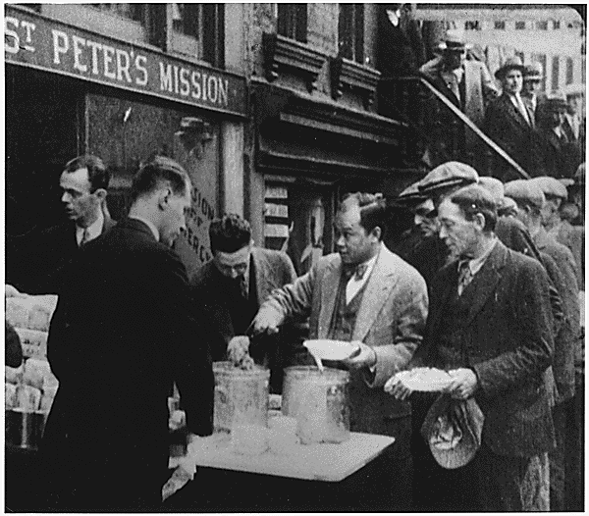
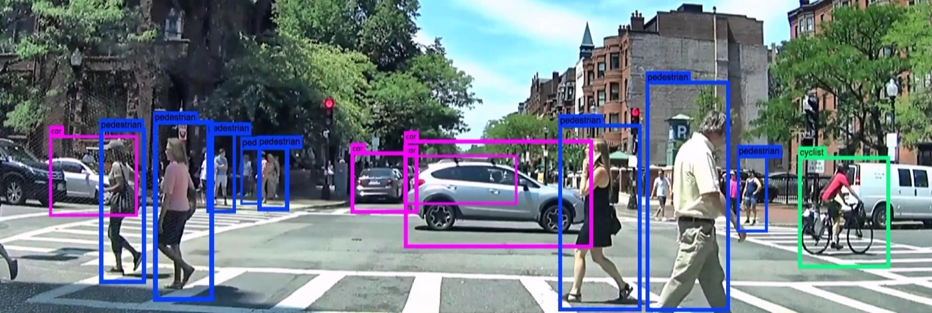
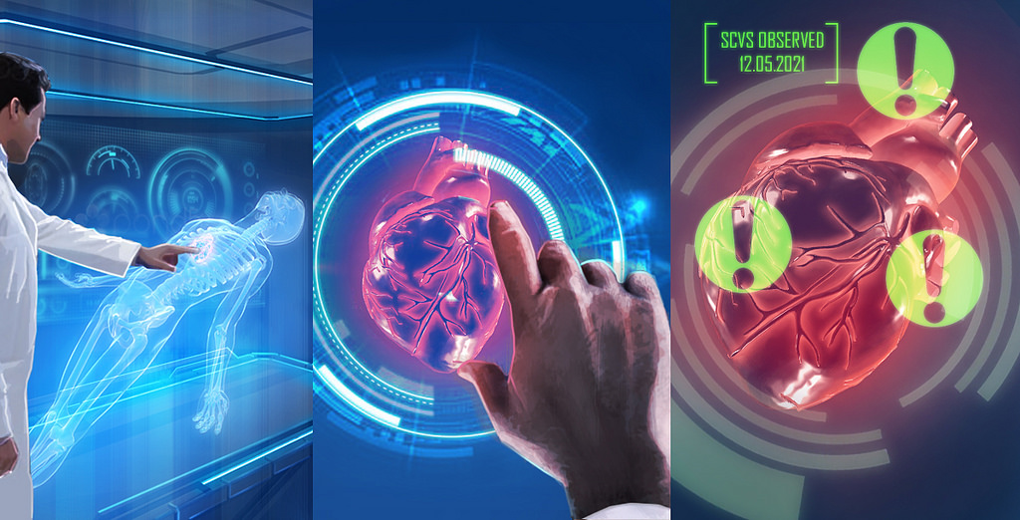
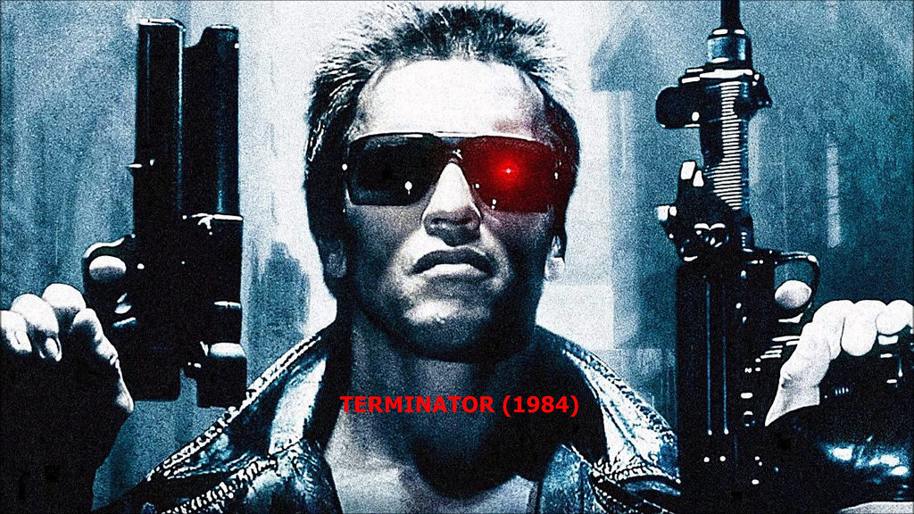
Applied AI – Industry Perspective
X
Photo credit: http://teaching.msa.maryland.gov/
X
Paul Townsend https://www.flickr.com/photos/brizzlebornandbred/21612930318
Credit: https://www.brother.co.uk/business-solutions/healthcare/future-of-hospital-technology
Notes:
AI, chatbots, NLP, automation, data, APIs, analytics, combinations
Ricky Ma, Kyle Hundman, Chris Mattman

Slide 5
Decide which AI to start with and experiment
Machine Learning – E.g., Deep Minds, Self driving cars, NASA Curiosity
Natural Language Processing (NLP) – ChatBots, Online help, NASA Mars
Computer Vision – Medical diagnosis, NASA Curiosity
Smart Robot - Roomba, Hube, JPL RovE, Open Source Rover, Div. Rob. Swarm
Intelligent Digital Assistant - Siri, Google, Cortana, Lex, RoomBot, Search
Speech to Text Translation – Google Translate, Azure Media Server, JPLTube
(7) Context Aware Computing – IBM Watson, Google Calendar, Waze, Acquisition
(8) Gesture Control – MS Kinect, Intel Realsense, JPL OnSight
(9) Speech Recognition – Helpdesk, online banking, JPL Alexa skills
(10) Automatic Content Recognition – Shazaam, YouTube, JPLTube, JPL Search
(11) Recommendation Engines – Amazon, Netflix, Chatbots, Research Assistant
Think and use “IA” to learn and gain adoption
Categories suggested by Access AI
(JPL examples in red)

Slide 6
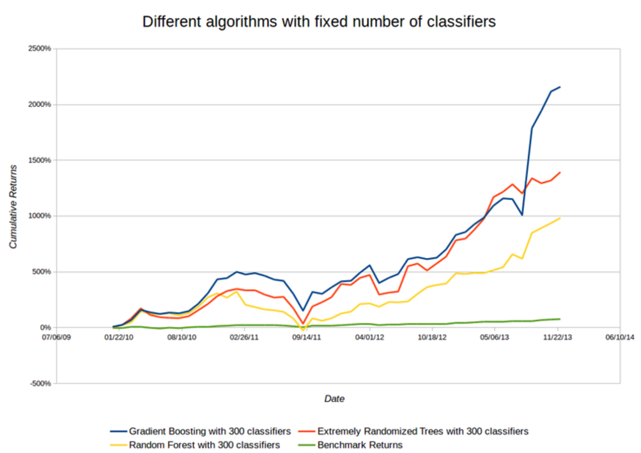
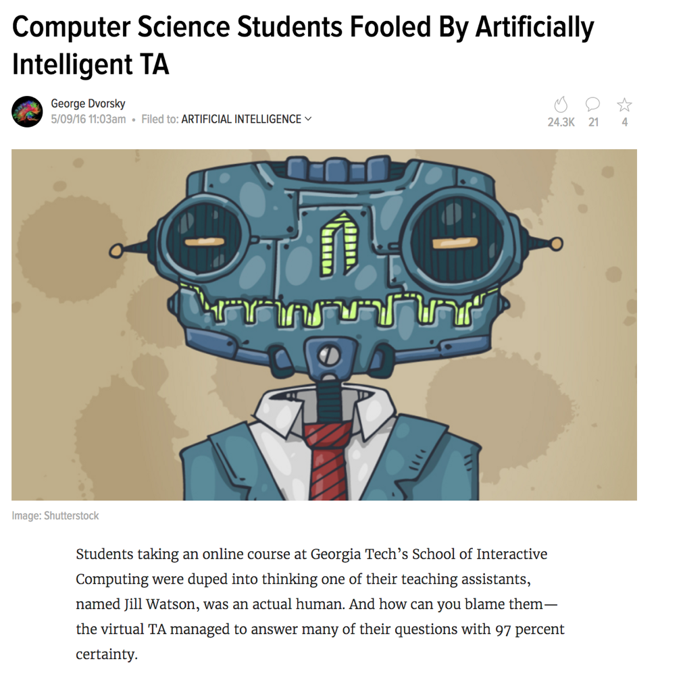
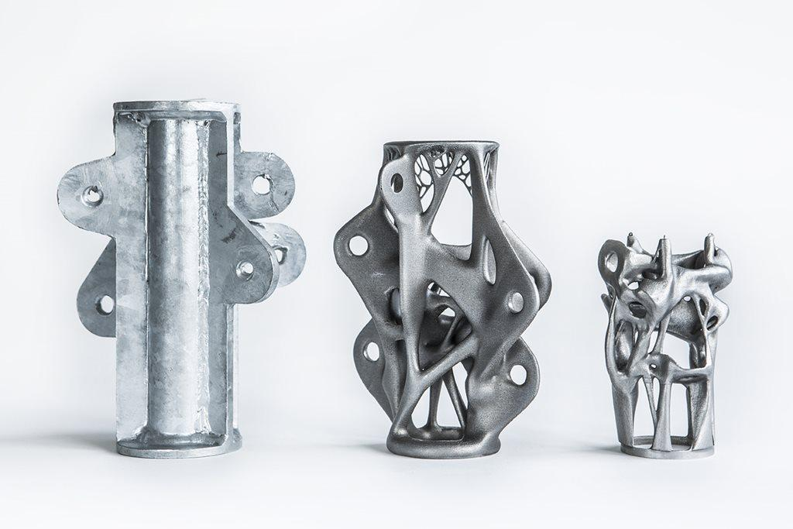
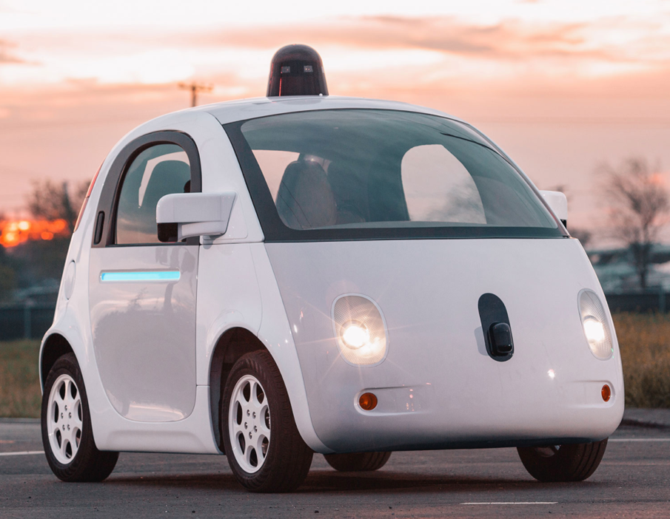
Applied AI opportunities: New algorithms, massive data sets, and Intelligent Assistants
ML and Stocks
1
2
3
Notes:
Watson was a digital TA
Huge trend in stocks to use ML for trends. Use a Q Learner Deep Learning algorithm so the computer makes similar data and trains on it.
Self driving cars eg Google’s Waymo car. “We’ve now launched the early rider program, a public trial of our self-driving cars in Phoenix, AZ, and we also continue to test every day in three other US locations.
We've tested our self-driving vehicles across multiple locations in the US, including cities like Mountain View, CA; Austin, TX; Kirkland, WA; and Metro Phoenix, AZ. By driving every day in different types of real-world conditions, we teach our cars to navigate safely and comfortably through all sorts of situations (https://waymo.com/ontheroad/)

Slide 7
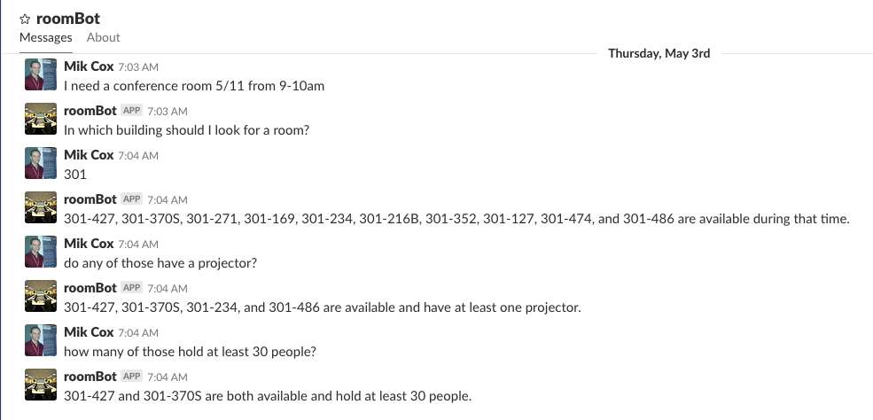
JPL’s RoomBot helps you find a conference room

Slide 8
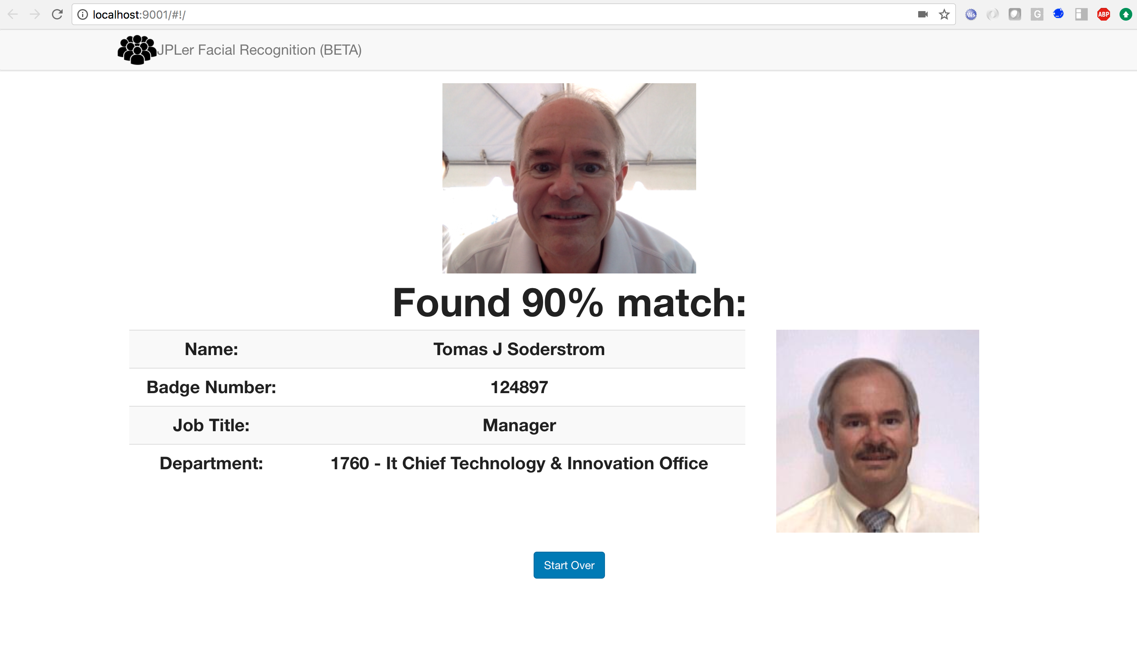
Is face recognition ready and helpful in our enterprises?
POC: R. Ma
Notes:
Example of ML applied to images. We want to have it work on parts, subassemblies.
Here’s someone we don’t know. If we train it correctly, here’s what we could find.

