Slide 1

Innovation at the Edge
How rapid experimentation with emerging technologies is achieving results on Earth and in Space
Tom Soderstrom, JPL IT Chief Technology and Innovation Officer
July 2018
Notes:
Title: Innovation at the Edge: How rapid experimentation with emerging technologies is achieving results on Earth and in Space
Presenter: Tom Soderstrom, IT Chief Technology and Innovation Officer, Jet Propulsion Laboratory
(30 minutes total)
Abstract: New technology comes in waves, and they are coming faster and larger than ever before. NASA’s Jet Propulsion Laboratory is actively surfing the most important technology waves that will affect everyone’s future, both on Earth and in Space. This talk will discuss how advances in technology, working in new ways, and thinking like a startup, can help us reach for answers to important questions for our businesses. Some of the technology waves that will be discussed includes how we can all benefit from Cloud Computing, Internet of Things, Augmented Reality, Intelligent Digital Assistants, and Artificial Intelligence. The presenter will also discuss upcoming missions to Space.

Slide 2

T
Why? To help us answer the BIG questions
How do we divert an asteroid?
How do we protect Mother Earth?
Are we alone?
How did the Universe form and where is it going?
Can we find Earth 2.0?
Is/was there life
on Mars?
Notes:
Theme: JPL is Daring Mighty Things as it attempts to answer the big questions of humankind. We are using cloud computing and the partnership with AWS has paid off and is going even deeper and farther. AWS has been and continues to be an innovation partner in Space Exploration. It is now mission critical for JPL.
JPL and NASA are searching for answers to big questions and going where no man or machine have gone before. A NASA Federally Funded Research Center, JPL’s motto is to Dare Mighty Things (both in Space and on the ground) as we attempt quests to help answer some big questions like… (fast pictures moving to the questions) … How can we help predict disasters on Earth? Is there life in Space? Can we find Earth 2.0? How could we protect Earth against a giant errant asteroid? Can we learn more about Mars so we could one day put humans on Mars?
Here are a few examples

Slide 3

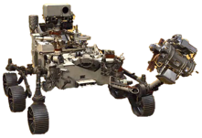
How can we infuse emerging technologies into the enterprise?
Enjoy the benefits of surfing (user experience)
and
leverage the power and future of the wave (back end)
and
spend time doing it (priorities and focus)

Slide 4

Our Vision of How We Will Work
Leverages IOT, Programming, Smart Data, Cloud, and Artificial Intelligence, which can evolve at different cadences
Sensors and Devices
(IoT)
Type
Click
APIs
(Registry)
Touch
AI / Machine Learning
Data Lakes
Deep Learning
Intelligent
Assistance
(IA)
Hear
Speak
Gesture
See
Sense
Think
Smell

Slide 5

What is the next Technology Tsunami?
Built-in
intelligence everywhere,
all the time

Slide 6


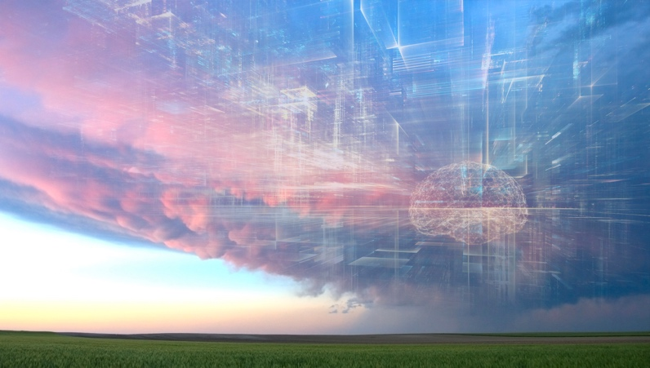
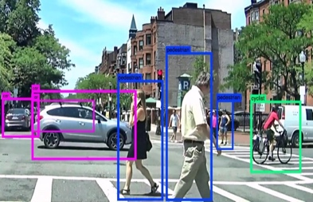

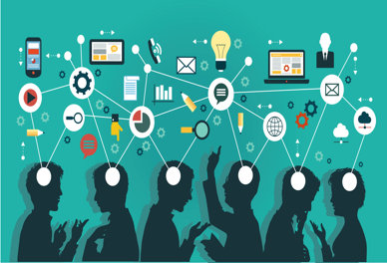
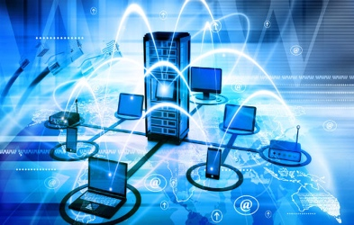
Surfing the next major technology waves - Summary
New Habits
Cyber Security challenges
  Work from anywhere, always connected, gaming, sharing, open source, reduced footprint, cord-cutting
  At scale, authentication, encryption by default, role-based training, BlockChain
Applied AI
Built in
intelligence
everywhere
  Deep Learning, Machine Learning, chatbots, NLP, automation, data-driven, APIs, analytics, combinations
Accelerated Computing
  Serverless, edge computing, HPC, GPUs, Neuromorphic, Quantum
Ubiquitous Computing
Software Defined Everything
  Mobile, smart devices, AR, IoT, NUI
  Programming everything, APIs, Software Defined Networks, containers, DevOps, Open Source, self-healing, everything distributed
These waves will impact everyone
These waves will impact primarily developers
Participate at: techwaves@jpl.nasa.gov
Notes:
https://goto.jpl.nasa.gov/techwaves
Other potentials:
From IDC: Technologies covered include distributed cloud, pervasive AI, composable applications, blockchain, diversified IoT, and more.
Everything as code, Automating Cyber Security for diversity and scale, Intelligent automation
1. Preparing for Software Defined Everything
Programming, SDN, containers, DevOps, Open Software, Intelligent network, devices
2. Accelerating the computing
Cloud, Serverless, cloud edge, HPC, GPUs, Quantum
3. Living mobile in a mixed reality
Mobile, smart devices, AR, IoT, NUI, customization
4. Automating Intelligence: Measuring & Automating Everything
AI, chatbots, NLP, automation, data, APIs, analytics, combinations
5. Handling Cyber Security challenges at scale
Scale, authentication, encryption, BlockChain
6. Adjusting to changing workforce expectations and habits
Work from anywhere, gaming, sharing, open source, reduced footprint, cord-cutting

Slide 7
Surfing the next major technology waves - New Habits
New Habits
Cyber Security challenges
  Work from anywhere, always connected, gaming, sharing, open source, reduced footprint, cord-cutting
Applied AI
Built in
intelligence
everywhere
Accelerated Computing
Ubiquitous Computing
Software Defined Everything
These waves will impact everyone
These waves will impact primarily developers
Participate at: techwaves@jpl.nasa.gov or https://goto.jpl.nasa.gov/techwaves
Notes:
Other potentials:
From IDC: Technologies covered include distributed cloud, pervasive AI, composable applications, blockchain, diversified IoT, and more.
Everything as code, Automating Cyber Security for diversity and scale, Intelligent automation
1. Preparing for Software Defined Everything
Programming, SDN, containers, DevOps, Open Software, Intelligent network, devices
2. Accelerating the computing
Cloud, Serverless, cloud edge, HPC, GPUs, Quantum
3. Living mobile in a mixed reality
Mobile, smart devices, AR, IoT, NUI, customization
4. Automating Intelligence: Measuring & Automating Everything
AI, chatbots, NLP, automation, data, APIs, analytics, combinations
5. Handling Cyber Security challenges at scale
Scale, authentication, encryption, BlockChain
6. Adjusting to changing workforce expectations and habits
Work from anywhere, gaming, sharing, open source, reduced footprint, cord-cutting

Slide 8

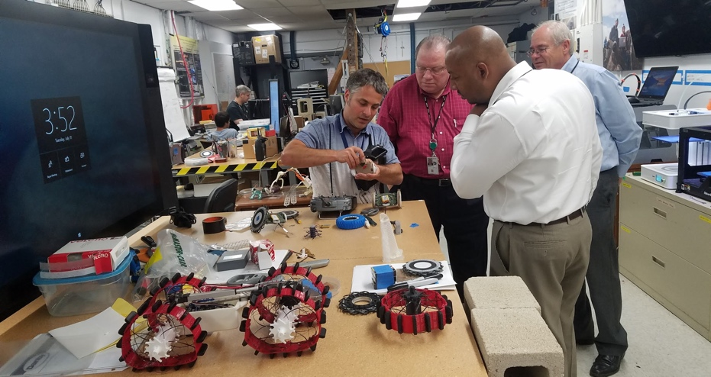
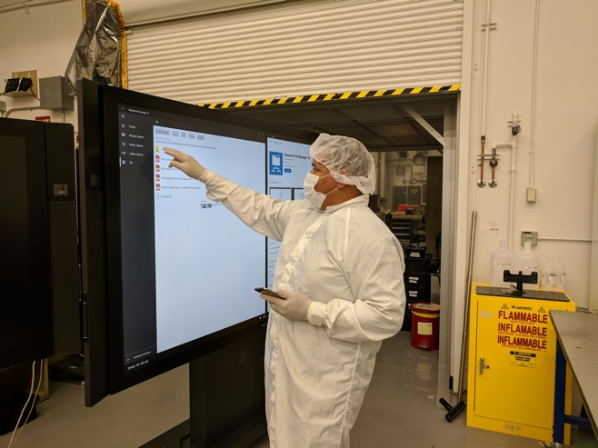
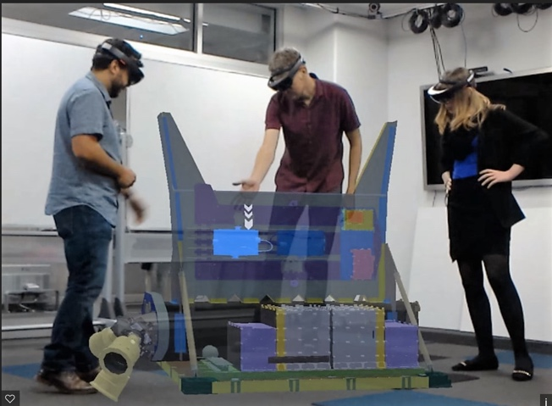
New Habits – JPL Perspective
    Work from anywhere
    Always connected to each other, our data, our devices
    Sensors everywhere give us constant insight
    3D print our future
    Experimentation makes us faster
    Open Source mentality helps us reuse and share
    Reconfiguring our offices at ease makes us nimble
    Crowdsourcing helps us develop faster (e.g. JPL Pitch Day, Parking App Challenge,
    Intelligent Digital Assistants, ChatBots, Open Source Rover)
Notes:
Work from anywhere, always connected, gaming, sharing, open source, reduced footprint, cord-cutting

Slide 9

Prepare for next generation of explorers’ ways of working
Notes:
The next generation of explorers, including you all, have much more knowledge. They will know what it looks like on their smartphones and NASA apps. They will expect it to work and be amazed with what they find. And we want their help. They are the future scientists and engineers. Whether they work for NASA or not, we want their help and participation.

Slide 10
Surfing the next major technology waves – Cyber Challenges
New Habits
Cyber Security challenges
  At scale, authentication, encryption by default,
  role-based training, BlockChain
Applied AI
Built in
intelligence
everywhere
Accelerated Computing
Ubiquitous Computing
Software Defined Everything
These waves will impact everyone
These waves will impact primarily developers
Participate at: techwaves@jpl.nasa.gov or https://goto.jpl.nasa.gov/techwaves
Notes:
Other potentials:
From IDC: Technologies covered include distributed cloud, pervasive AI, composable applications, blockchain, diversified IoT, and more.
Everything as code, Automating Cyber Security for diversity and scale, Intelligent automation
1. Preparing for Software Defined Everything
Programming, SDN, containers, DevOps, Open Software, Intelligent network, devices
2. Accelerating the computing
Cloud, Serverless, cloud edge, HPC, GPUs, Quantum
3. Living mobile in a mixed reality
Mobile, smart devices, AR, IoT, NUI, customization
4. Automating Intelligence: Measuring & Automating Everything
AI, chatbots, NLP, automation, data, APIs, analytics, combinations
5. Handling Cyber Security challenges at scale
Scale, authentication, encryption, BlockChain
6. Adjusting to changing workforce expectations and habits
Work from anywhere, gaming, sharing, open source, reduced footprint, cord-cutting

